Slide 1

23 Oct 2025

Slide 2
🤖 MATLAB with AI From Code Generation to Engineering Application
Workshop Outline
🟩 Part 1 – Basics with MATLAB and Assisted Generative AI
Learn MATLAB programming fundamentals and explore how MATLAB’s built-in generative AI assistant helps write and explain code.
🟨 Part 2 – MATLAB for AI and Data Science
Learn how MATLAB supports machine learning, data visualization, and model training using built-in apps and AI-assisted coding.
🟦 Part 3 – Demo: From Model to App
A quick end-to-end demo of training a small model in MATLAB to predict outcomes from sample data (e.g., regression or classification).
Duration: 60 minutes
Duration: 75 minutes
Duration: 45 minutes

Slide 3
PART 1
🟩 Basics with MATLAB and Assisted Generative AI
Learning Outcomes:
Understand MATLAB workspace, syntax, and data structures
Apply AI-assisted code generation for basic programming tasks
Create and visualize mathematical functions using plots
Gain confidence in interactive MATLAB scripting

Slide 4

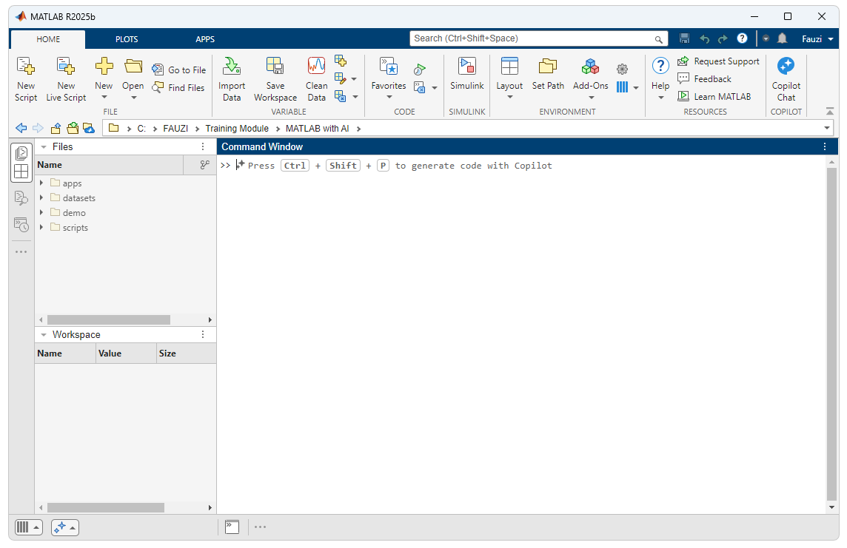
Introduction
!git clone https://github.com/m0fauzi/matlab_with_ai.git

Slide 5
MATLAB Script or Live Script?
Feature | MATLAB Script (.m) | MATLAB Live Script (.mlx)
File Type | Plain text | Rich interactive document
Content Type | Code only | Code + text + images + equations
Purpose | Coding, automation, and deployment | Teaching, reporting, tutorials
Inline Output | Not shown inline (separate figure/output window) | Shown inline (within the document)
Formatted Text & Math | Not supported | Supported (Markdown and LaTeX)
Images & Tables | Not supported directly | Supported directly inside document
Ease of Version Control | Easy (plain text diff) | Harder (binary format)
File Extension | .m | .mlx
Execution Style | Sequential command/script execution | Interactive section-by-section execution
Conversion | Can be converted to .mlx via “Save As > Live Script” | Can be exported to .m via “Save As > Script”
Best For | Reusable code, automation tasks | Teaching, demonstration, documentation

Slide 6
Basic MATLAB programming
Basics
Operations
Control Flow
Conditions
Loop
Functions
Plotting
Tips
a = 5; % Assignment
b = [1 2 3]; % Row vector
c = [1; 2; 3]; % Column vector
A = [1 2; 3 4]; % Matrix
disp(a) % Display value
if a > 0
disp('Positive')
elseif a == 0
disp('Zero')
else
disp('Negative')
end
x + y % Addition
x .* y % Elementwise multiply
A * B % Matrix multiply
x.^2 % Elementwise power
mean(x) % Built-in function
for i = 1:5
disp(i)
end
while a < 10
a = a + 1;
end

Slide 7
Basic MATLAB programming
Basics
Operations
Control Flow
Conditions
Loop
Functions
Plotting
Tips
function y = squareNum(x)
y = x.^2;
end
Call with:
result = squareNum(4);
Use clc, clear, close all to reset workspace
Use % for comments
Use help functionname for quick documentation
Use .m for scripts, .mlx for live scripts
x = 0:0.1:10;
y = sin(x);
plot(x, y, 'r--','LineWidth',2);
xlabel('x'); ylabel('sin(x)');
title('Sine Wave');

Slide 8


Example 1
Goal: Plot the sine function $y=\sin\left(x\right)$ where $−2π<x<2π$
Steps:
Create a new script or Live Script in MATLAB.
Type and run the following code:
Observe the smooth oscillating curve from −2π to 2π.
x = -2*pi : 0.1 : 2*pi; % Define x values
y = sin(x); % Compute y = sin(x)
plot(x, y, 'b', 'LineWidth', 2) % Plot the curve
xlabel('x'); ylabel('sin(x)');
title('Sine Function');
grid on;
https://bit.ly/matlab-with-ai
/scripts/Example_1.m

Slide 9
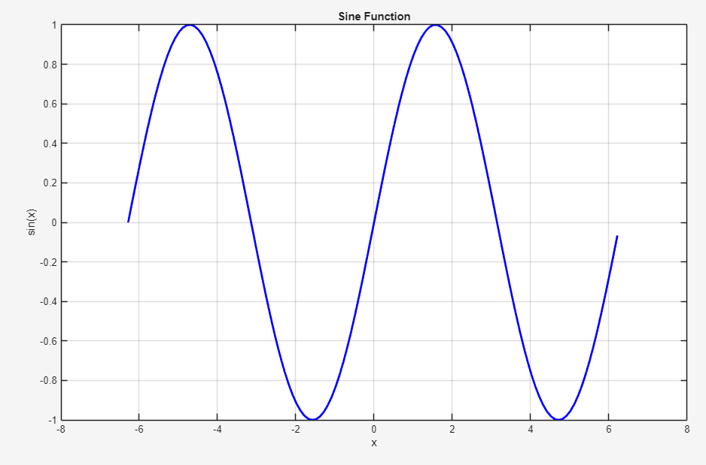
Example 1 - Result

Slide 10
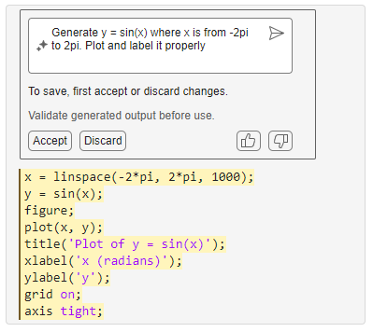

Generate Code by using prompt
Goal: Learn how to use MATLAB’s Prompt-based Code Generation to create a plot automatically.
Step:
In the Live Editor, locate the prompt icon (CTRL + SHIFT + P).
Type this prompt:
Press Enter or click Run Prompt.
MATLAB will automatically generate the corresponding code block.
Review and validate the generated code before executing — always make sure it produces the expected result.
Click Accept to insert the generated code into your Live Script, then Run it to see the plot.
Generate y = sin(x) where x is from -2pi to 2pi. Plot and label it properly

Slide 11
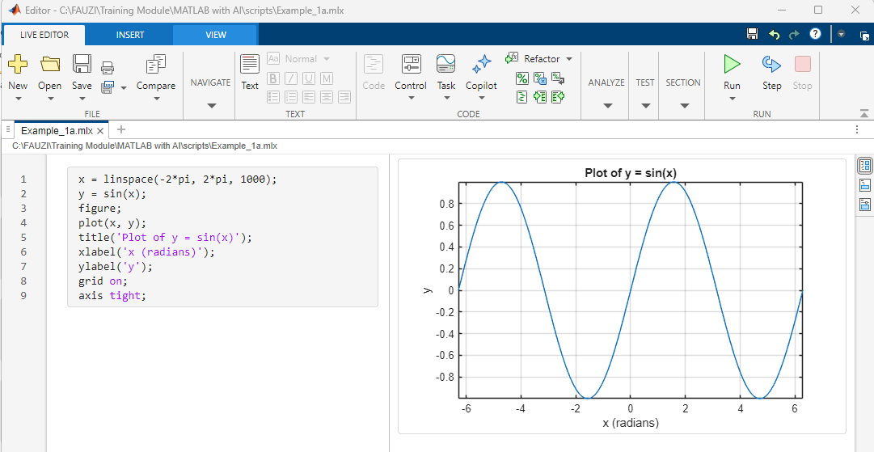
Example 1 - Result

Slide 12
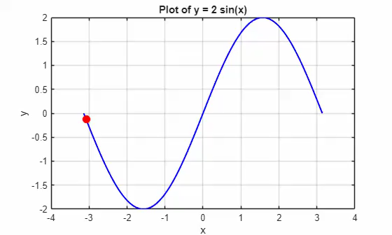
💪 Challenge 1: Moving Point on Sine Curve
Goal: Animate a red point moving along the curve
https://bit.ly/matlab-with-ai
/scripts/Challenge_1.mlx
Duration: 10 Minutes

Slide 13
End of Part 1
🟩 Recaps:
MATLAB Interface & Live Script
Variables, Arrays, and Functions
Using AI Prompts to Generate Code
Hands-on: Plot and animate a moving dot

Slide 14
PART 2
🟨 MATLAB for AI and Data Science
Learning Outcomes:
Understand workflow for AI and data science
Perform data preprocessing and visualization
Train and evaluate simple predictive models
Use AI assistance to automate and interpret data analysis steps

Slide 15
1. The End-to-End Workflow
MATLAB provides an integrated environment for the full AI and Data Science cycle — from raw data to actionable insights.
Step | Description | MATLAB Functions / Tools
1. Data Acquisition | Collect or import data from Excel, CSV, sensors, or databases. | readtable, xlsread, database, webread
2. Data Preprocessing | Clean, normalize, handle missing data, detect outliers. | rmmissing, fillmissing, normalize, isoutlier
3. Data Exploration | Visualize and understand data patterns. | plot, scatter, histogram, heatmap, corrplot
4. Feature Engineering | Extract key variables or transform data for better model performance. | table2array, zscore, categorical, grpstats
5. Model Training (AI/ML) | Train predictive models — regression or classification. | fitlm, fitctree, fitcsvm, Classification Learner
6. Model Evaluation | Measure performance and validate accuracy. | confusionchart, loss, crossval, R², RMSE
7. Deployment & Insight Generation | Predict new outcomes and visualize insights. | predict, bar, surf, exportgraphics, App Designer

Slide 16

2. AI Coverage in MATLAB
MATLAB supports both Regression (continuous) and Classification (discrete).
🔸 Regression Models
Examples:
Predicting flower species (Iris dataset)
Classifying defective parts
Identifying handwritten digits
Used to predict numeric outcomes.
🔹 Classification Models
Used to predict categorical outcomes.
Classification Models
Examples:
Predicting house prices
Estimating car fuel efficiency
Modeling sensor readings
Regression Models

Slide 17
🔸 Regression Models in MATLAB
Model Type | Description | MATLAB Function(s)
Linear Regression | Predict continuous (Y) as a linear combination of predictors. (MathWorks) | fitlm(X,Y)
Generalized Linear Models (GLM) | Linear predictor + link function + distribution (e.g., logistic, Poisson, gamma) for continuous response. (MathWorks) | fitglm(X,Y,…)
Nonlinear Regression | Models where the relationship is nonlinear in the parameters (parametric nonlinear forms). (MathWorks) | fitnlm(X,Y,modelFunc)
Regression Tree | Decision-tree based regression, handles nonlinear & non-parametric relationships. (MathWorks) | fitrtree(X,Y)
Ensemble of Regression Trees | Bagging/boosting of multiple regression trees for improved accuracy. (MathWorks) | fitrensemble(X,Y)
Support Vector Regression (SVR) | SVM extended for continuous responses (kernel methods, etc). (MathWorks) | fitrsvm(X,Y)
Gaussian Process Regression (GPR) | Nonparametric kernel‐based regression modelling responses as Gaussian processes; often gives uncertainty estimates. (MathWorks) | fitrgp(X,Y)
Generalized Additive Models (GAM) for Regression | Models that add shape‐functions of predictors (splines etc) for flexible regression. (MathWorks) | fitrgam(X,Y)
Neural Network Regression | Regression using neural networks (shallow or deep) for continuous responses. (MathWorks) | fitrnet(X,Y)

Slide 18
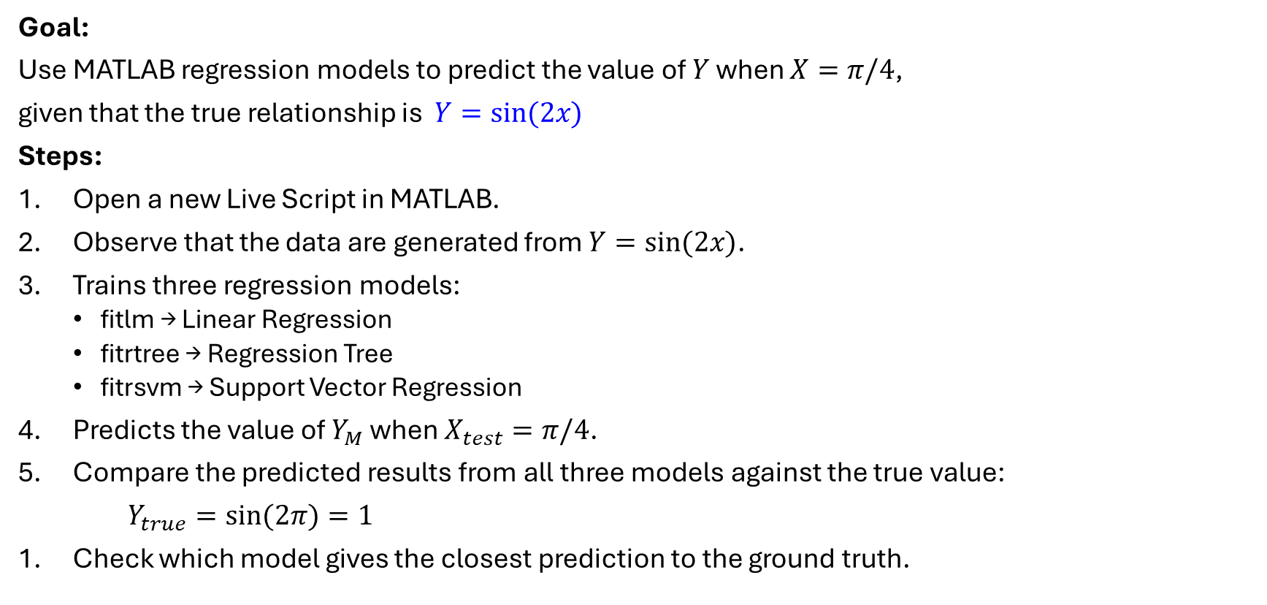
Example 2 - Predict $Y$for $X=π/4$
Goal:
Use MATLAB regression models to predict the value of $Y$ when $X=π/4$,
given that the true relationship is $Y=sin⁡(2x)$
Steps:
Open a new Live Script in MATLAB.
Observe that the data are generated from $Y=sin⁡(2x)$.
Trains three regression models:
fitlm → Linear Regression
fitrtree → Regression Tree
fitrsvm → Support Vector Regression
Predicts the value of $Y_{M}$ when $X_{test}=π/4$.
Compare the predicted results from all three models against the true value:
$Y_{true}=sin⁡(2π)=1$
Check which model gives the closest prediction to the ground truth.

Slide 19
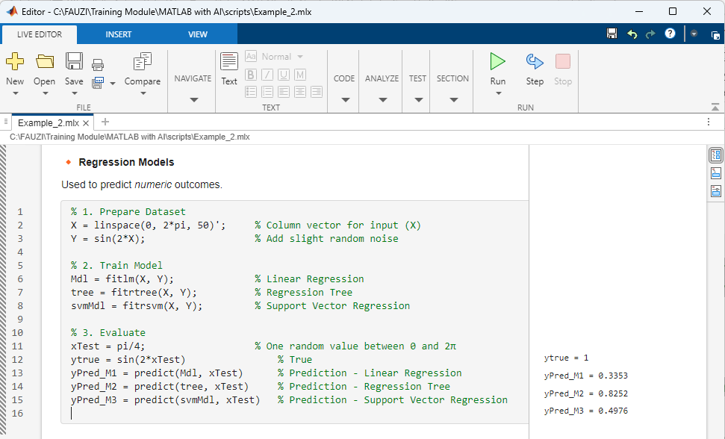
Example 2 - Result
Try-It-Yourself: Expand the input vector and watch how model predictions vary.

Slide 20
2. AI Coverage in MATLAB
MATLAB supports both Regression (continuous) and Classification (discrete).
🔸 Regression Models
Examples:
Predicting flower species (Iris dataset)
Classifying defective parts
Identifying handwritten digits
Used to predict numeric outcomes.
🔹 Classification Models
Used to predict categorical outcomes.
Classification Models
Examples:
Predicting house prices
Estimating car fuel efficiency
Modeling sensor readings
Regression Models

Slide 21
🔹 Classification Models in MATLAB
Model Type | Description | MATLAB Function(s)
Decision Tree Classifier | Builds a tree of decision rules splitting input features to predict class labels. (MathWorks) | fitctree(X,Y)
Linear Discriminant / Quadratic Discriminant Analysis | Assumes classes generate data from different Gaussian distributions; useful for interpretable boundaries. (MathWorks) | fitcdiscr(X,Y)
Logistic Regression (Binary GLM for classification) | Models class membership probabilities via a logistic function (for binary classification). (MathWorks) | fitglm(X,Y,'Distribution','binomial') (or fitclinear with logistic)
Nearest Neighbors Classifier (k-NN) | Classifies a sample based on the labels of its nearest neighbours in feature space. (MathWorks) | fitcknn(X,Y)
Naive Bayes Classifier | Assumes predictor independence given the class; useful for multiclass problems with speed and simplicity. (MathWorks) | fitcnb(X,Y)
Support Vector Machine (SVM) Classifier | Builds hyperplanes (or kernel-based boundaries) to separate classes; used for both binary and multiclass via ECOC. (MathWorks) | fitcsvm(X,Y) (binary) / fitcecoc(X,Y) (multiclass)
Kernel / Nonlinear Classifier | Uses kernels or feature expansion to allow non-linear decision boundaries. (MathWorks) | fitckernel(X,Y)
Ensemble Classifiers | Combines multiple base learners (trees, SVMs, etc) for improved performance (bagging, boosting). (MathWorks) | fitcensemble(X,Y)
Neural Network Classification Models | Uses neural networks (shallow or deep) to learn complex relationships for classification tasks. (MathWorks) | fitcnet(X,Y) (or via Deep Learning toolbox)
Multiclass Error-Correcting Output Codes (ECOC) Model | Framework to handle multiclass via multiple binary learners (often SVMs) with coding matrix. (MathWorks) | fitcecoc(X,Y)

Slide 22
Example 3 - Classification Models in MATLAB
Goal: Classify flower species
Steps:
Open a new Live Script in MATLAB.
Observe the dataset (built-in Fisher).
Split dataset to training and validation
Trains three classification models:
fitctree → Decision Tree Classifier
fitcecoc → Multiclass Error-Correcting Output Codes
fitcknn → Nearest Neighbors Classifier
Check which model gives the closest prediction.

Slide 23
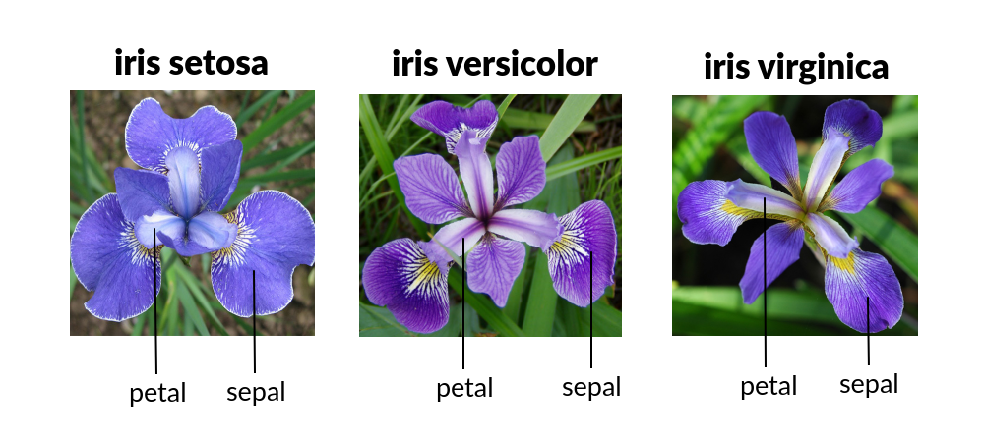
Example 3 - Observe the dataset
Goal: Classify flower species

Slide 24
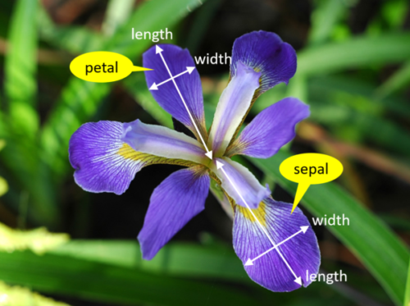
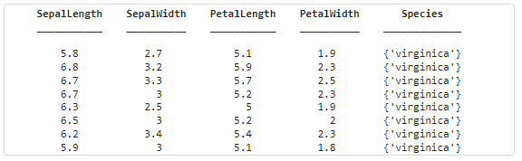
Example 3 – Dataset (built-in Fisher)
Goal: Classify flower species
Species | Group Count | mean_Sepal Length | std_Sepal Length | mean_SepalWidth | std_Sepal Width | mean_Petal Length | std_Petal Length | mean_PetalWidth | std_Petal Width
'setosa' | 50 | 5.006 | 0.3525 | 3.428 | 0.3791 | 1.462 | 0.1737 | 0.246 | 0.1054
'versicolor' | 50 | 5.936 | 0.5162 | 2.77 | 0.3138 | 4.26 | 0.4699 | 1.326 | 0.1978
'virginica' | 50 | 6.588 | 0.6359 | 2.974 | 0.3225 | 5.552 | 0.5519 | 2.026 | 0.2747

Slide 25
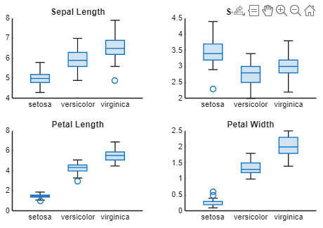
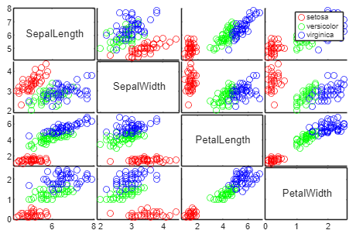
Example 3 – Dataset (built-in Fisher)
Pairwise Feature Visualization
Distribution by Feature

Slide 26
Example 3 - Classification Models in MATLAB
Goal: Classify flower species
Steps:
Open a new Live Script in MATLAB.
Observe the dataset (built-in Fisher).
Split dataset to training and validation
Trains three classification models:
fitctree → Decision Tree Classifier
fitcecoc → Multiclass Error-Correcting Output Codes
fitcknn → Nearest Neighbors Classifier
Check which model gives the closest prediction.
Prompt –
Goal: Classify flower species. Prepare code to follow step below
1. Load dataset
2. Split 70/30 for train/validation
3. Train 3 models using (fitctree, fitcecoc, fitcknn)
4. Do single test for input [5, 3.4, 1.5,0.2]

Slide 27
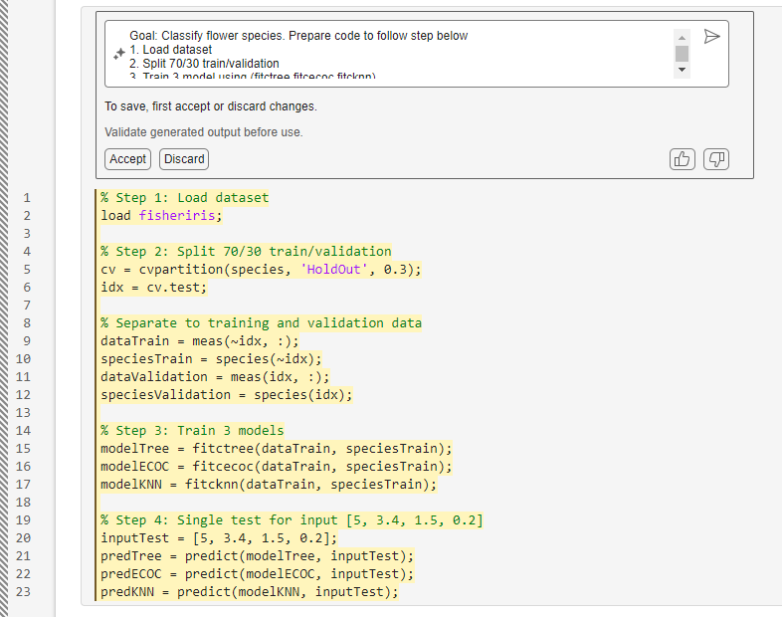
Prompt –
Goal: Classify flower species. Prepare code to follow step below
1. Load dataset
2. Split 70/30 for train/validation
3. Train 3 models using (fitctree, fitcecoc, fitcknn)
4. Do single test for input [5, 3.4, 1.5,0.2]

Slide 28
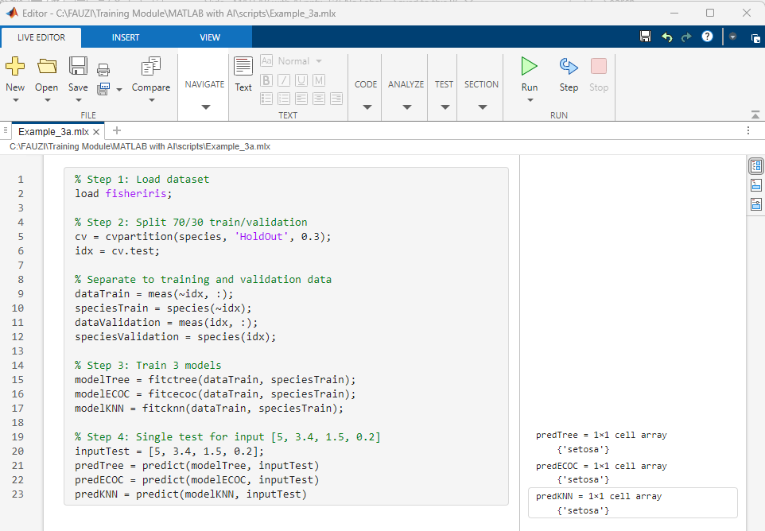
Example 3 – Result
https://bit.ly/matlab-with-ai
/scripts/Example_3a.mlx

Slide 29
Example 3 – Result
Species | Group Count | mean_Sepal Length | std_Sepal Length | mean_SepalWidth | std_Sepal Width | mean_Petal Length | std_Petal Length | mean_PetalWidth | std_Petal Width
'setosa' | 50 | 5.006 | 0.3525 | 3.428 | 0.3791 | 1.462 | 0.1737 | 0.246 | 0.1054
'versicolor' | 50 | 5.936 | 0.5162 | 2.77 | 0.3138 | 4.26 | 0.4699 | 1.326 | 0.1978
'virginica' | 50 | 6.588 | 0.6359 | 2.974 | 0.3225 | 5.552 | 0.5519 | 2.026 | 0.2747

Slide 30
Challenge 2: Air Quality
The dataset includes 9,358 hourly records collected from five metal oxide gas sensors in an air quality monitoring device placed at road level in a polluted Italian city.
Data were recorded from March 2004 to February 2005, making it one of the longest publicly available real-world sensor datasets.
Each record includes:
Sensor responses (5 metal oxide sensors)
Reference measurements for CO, Non-Methane Hydrocarbons, Benzene, NOx, and NO₂
The dataset shows cross-sensitivity, concept drift, and sensor drift effects, which influence accuracy over time (as discussed in De Vito et al., Sensors and Actuators B, 2008).
Missing values are represented by –200.
https://bit.ly/matlab-with-ai
/dataset/AirQualityUCI.csv

Slide 31
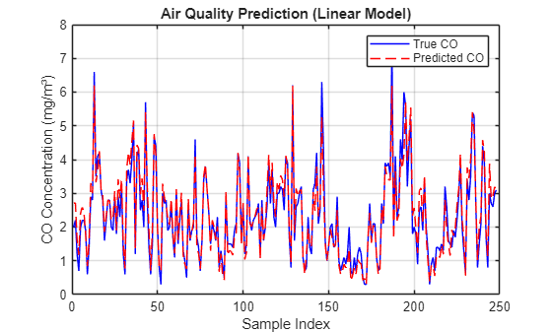
Challenge 2: Air Quality
Goal:
Predict CO concentration (mg/m³) using readings from 5 metal oxide sensors.
https://bit.ly/matlab-with-ai
/scripts/Challenge_2.mlx
Models | RMSE
'Linear Regression' | 0.334
'Regression Tree' | 0.3845
'SVM Regression' | 1.1917

Slide 32
End of Part 2
🟨 Recaps:
Importing and Cleaning Datasets
Exploratory Data Visualization
Training Simple ML Models (Regression, Classification)
Using AI Prompts for code programming

Slide 33
PART 3
🟦 Demo: From Model to App
Learning Outcomes:
Create a simple interactive app using MATLAB App Designer.
Integrate a trained model to make predictions within the app.
Build a hands-on workflow: Upload CSV → Predict → Display Results.

Slide 34
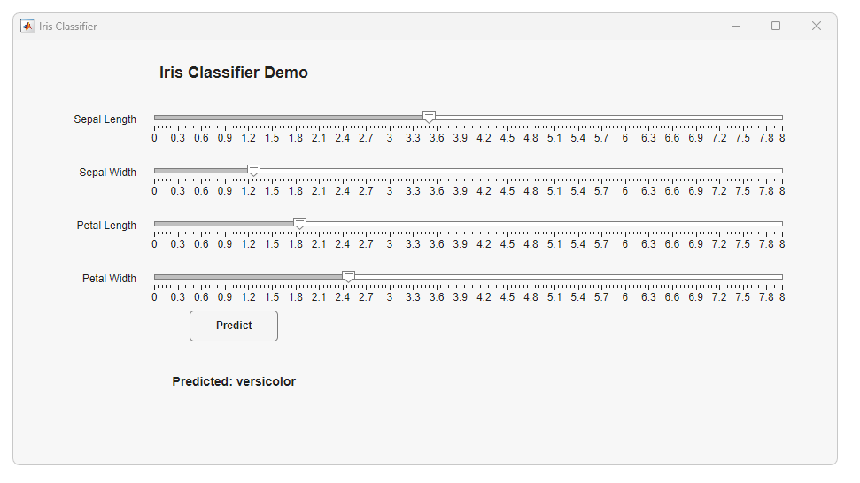
Sample APP 1
https://bit.ly/matlab-with-ai
/apps/IrisClassifierApp.m

Slide 35
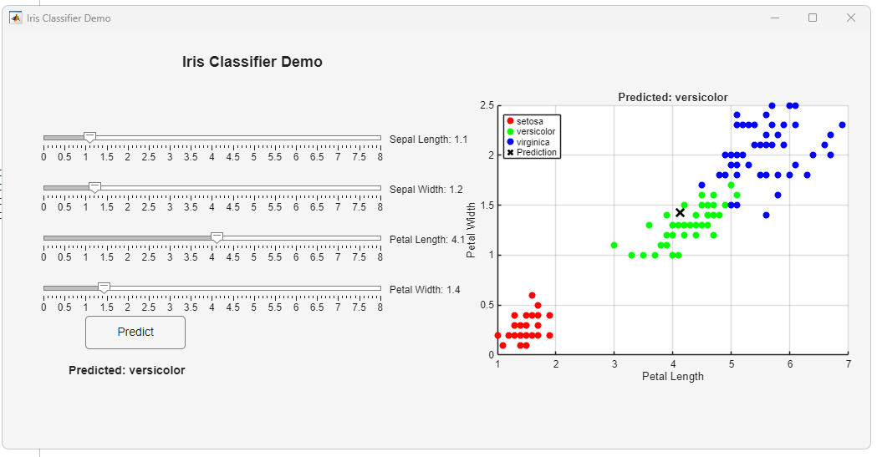
Sample APP 2
https://bit.ly/matlab-with-ai
/apps/IrisClassifierApp_2.m

Slide 36
End of Part 3
🟦 Recaps:
End-to-End Model Workflow
Model Training and Validation
Making Predictions with New Inputs
Visualizing Results and Discussion

